Slide 1
Recurrent Neural Networks: Theory, Mathematics, and Sequential Modeling

Slide 2
Learning Objectives
By the end of this lecture, students will be able to:
Define Recurrent Neural Networks (RNNs) and explain their unique architecture.
Relate RNN operations to the equation of a line in linear algebra.
Describe the forward pass and backpropagation through time (BPTT) processes.
Identify the challenges of training RNNs, including long-term dependencies.
Explain why RNNs are well suited for sequential modeling tasks.

Slide 3
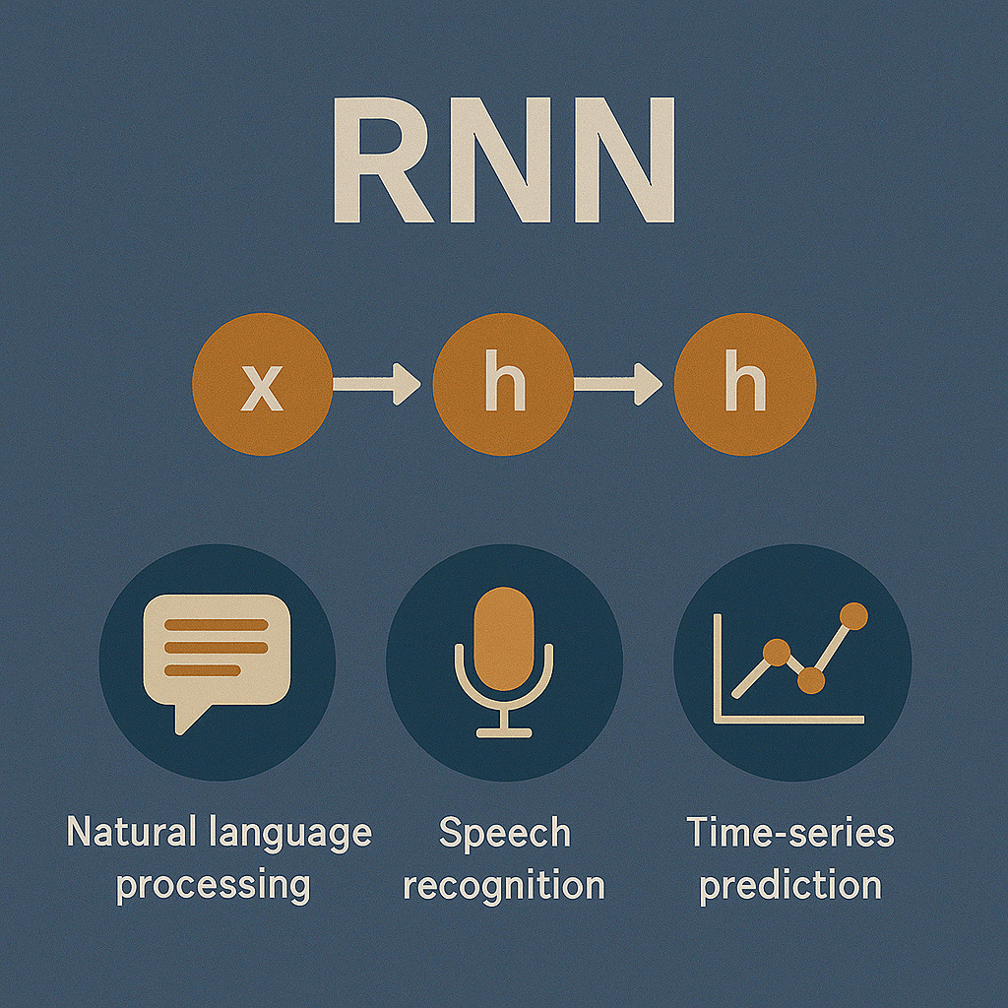
Introduction to RNN model
Recurrent Neural Networks for Sequential Data
RNNs are a class of neural networks designed to handle data with temporal or sequential dependencies (Cho, Bahdanau, Bougares, Schwenk, & Bengio, 2014).
Unlike feedforward networks, RNNs include recurrent connections that pass information from previous time steps via hidden states.
Key applications:
Natural language processing (translation, summarization)
Speech recognition
Time-series prediction
Core idea: Model a sequence by processing one element at a time while maintaining an internal memory.
Recurrent Neural Networks (RNNs) Overview

Slide 4
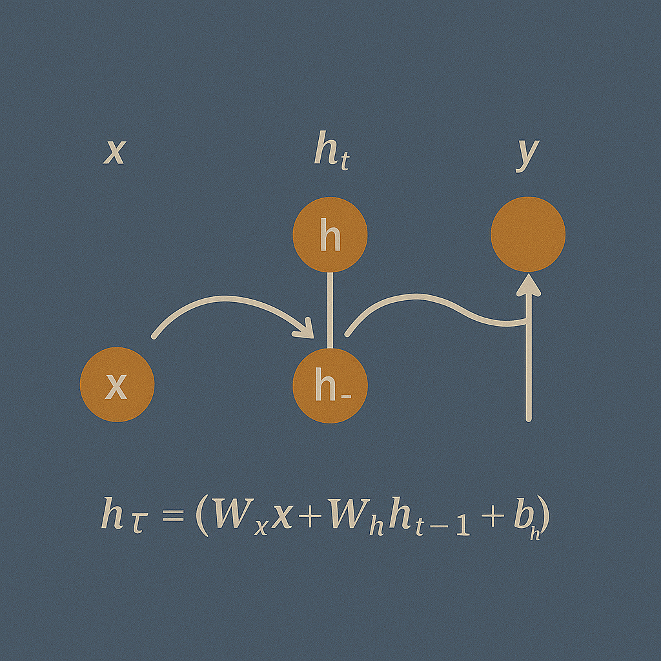
Core Architecture
Inputs (x_{t​}) are processed at each time step t.
Hidden state (h_{t}​) retains contextual information from prior steps.
Outputs (y_{t}​) can be produced at each step or after the final time step.
Update equation:
h_{t}=σ(W_{xh}x_{t} + W_{hh}h_{t−1}+b_{h})
The same weights (W_{xh}, W_{hh}​) are reused at every time step (weight sharing).

Slide 5
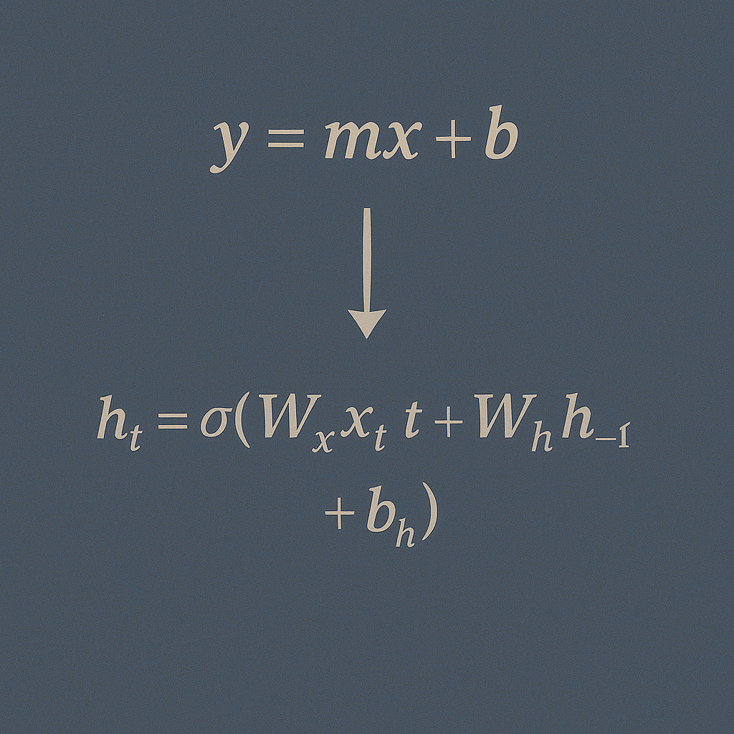
The Equation of a Line as the Foundation
From Linear Models to Recurrent Neural Networks
Equation of a line in slope-intercept form:
𝑦=𝑚𝑥+𝑏
Neural network layers generalize this with vector-matrix multiplication:
𝑦=𝑊𝑥+𝑏
In RNNs, the linear transformation is applied to both the current input (𝑥_{𝑡}) and the previous hidden state (ℎ_{𝑡}−​1):
ℎ_{𝑡}=𝜎(𝑊_{𝑥ℎ} 𝑥_{𝑡}+𝑊_{ℎℎ}ℎ_{𝑡−1}+𝑏_{ℎ})
This shows that RNNs build on the same fundamental concept but extend it to include historical context.

Slide 6
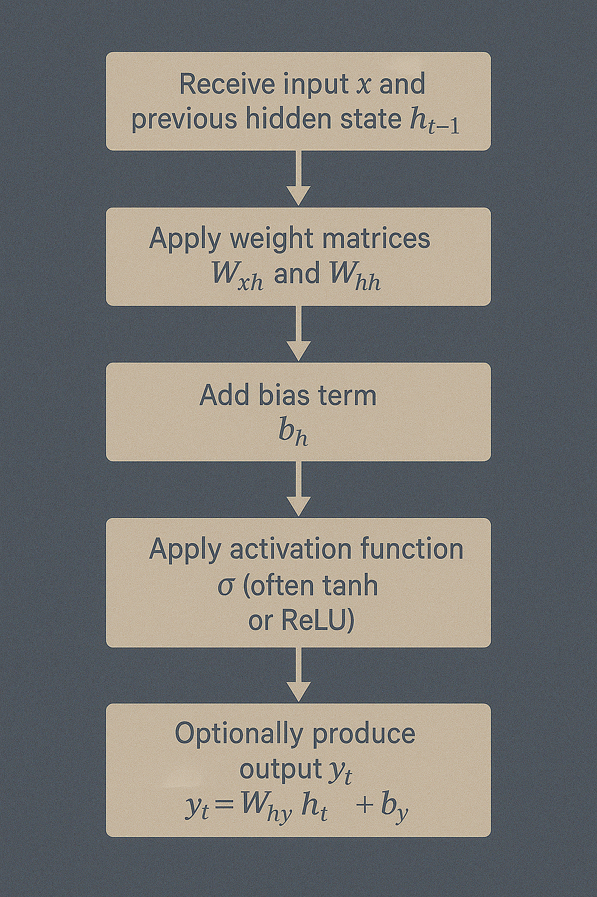
Forward Pass Mechanics
Receive input 𝑥_{𝑡}​ and previous hidden state ℎ_{𝑡−1}.
Apply weight matrices 𝑊_{𝑥ℎ} and 𝑊_{ℎℎ}​ .
Add bias term 𝑏_{ℎ}​ .
Apply activation function 𝜎 (often tanh or ReLU).
Update hidden state ℎ_{𝑡}​ .
Optionally produce output 𝑦_{𝑡}=𝑊_{ℎ𝑦}ℎ_{𝑡}+𝑏_{𝑦}.

Slide 7

Backpropagation Through Time (BPTT)
Unroll the RNN across all time steps.
Compute loss at each step (if applicable).
Backpropagate errors through the unrolled network (Bengio, Simard, & Frasconi, 1994).
Challenges:
Vanishing gradients: Gradients shrink, making it hard to learn long-term dependencies.
Exploding gradients: Gradients grow uncontrollably, destabilizing learning.
Gradient clipping can address exploding gradients.

Slide 8
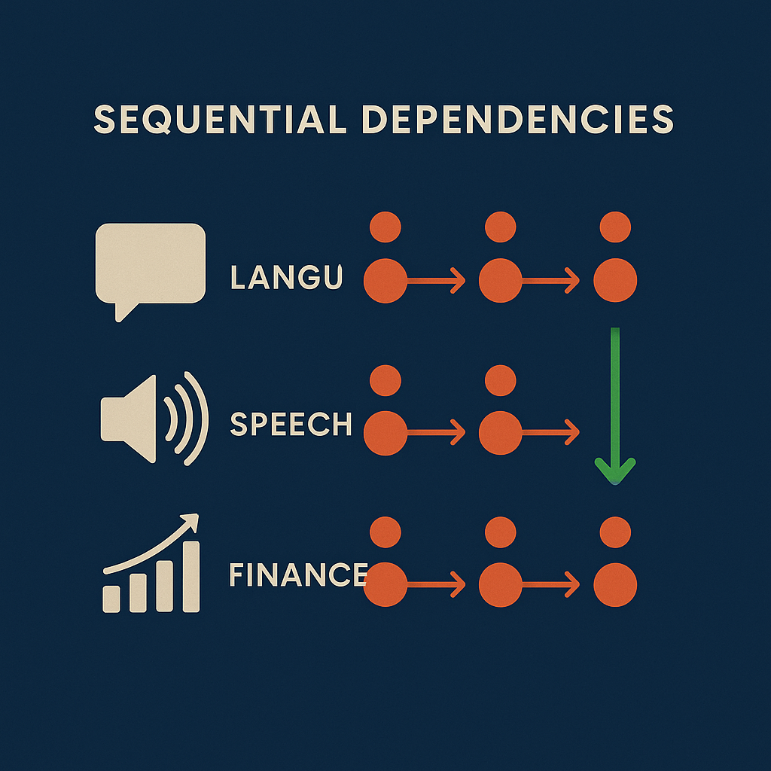
Why RNN modeling for Sequential Data
Sequential data has temporal dependencies — each element may depend on previous elements.
RNNs maintain an internal state, enabling them to capture short-term dependencies effectively.
Examples:
Language: The meaning of a word depends on previous words.
Speech: Interpretation of a phoneme depends on preceding sounds.
Finance: Future prices depend on historical trends.

Slide 9
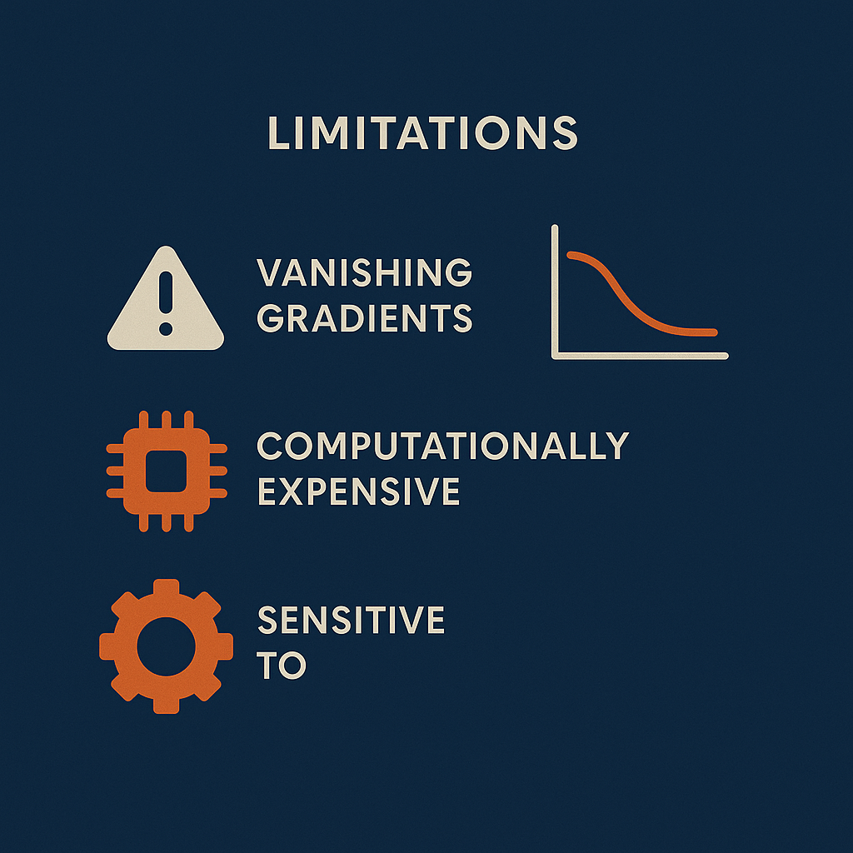
Limitations
Difficulty learning long-term dependencies due to vanishing gradients (Bengio, Simard, & Frasconi, 1994).
Computationally expensive for very long sequences.
Sensitive to hyperparameters (learning rate, sequence length).

Slide 10
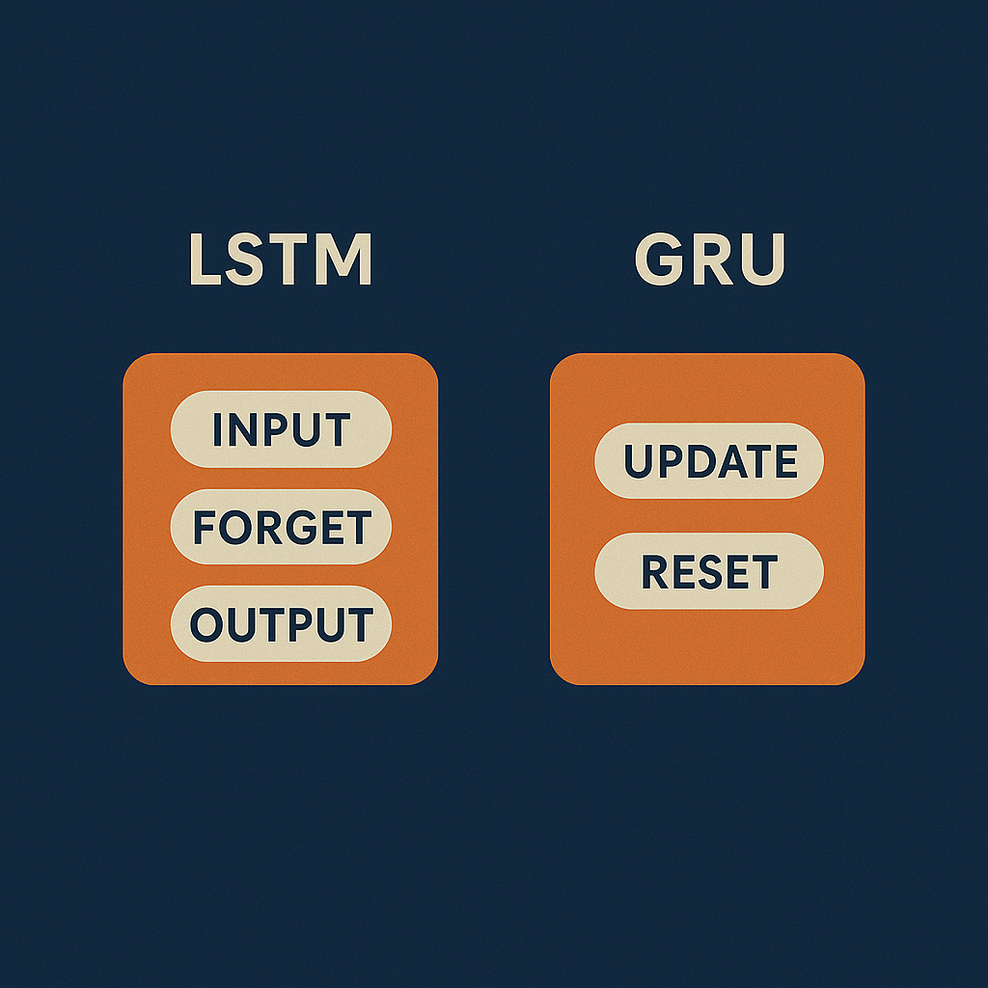
Extensions
LSTM (Long Short-Term Memory): Introduces gates (input, forget, output) to regulate information flow and preserve long-term dependencies (Hochreiter & Schmidhuber, 1997).
GRU (Gated Recurrent Unit): Simplifies LSTM architecture while retaining performance benefits (Cho, Bahdanau, Bougares, Schwenk, & Bengio, 2014).
These architectures significantly mitigate vanishing gradient issues.

Slide 11
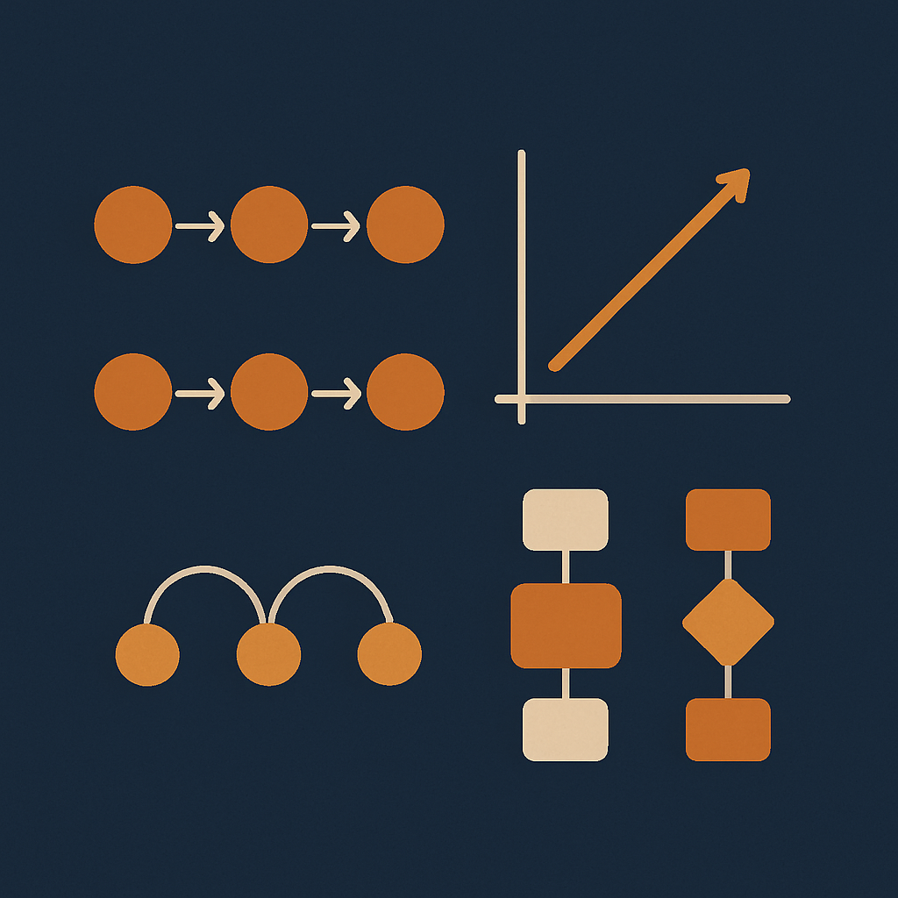
Summary
RNNs extend basic linear transformations to sequences by incorporating historical context via hidden states.
Based on the same mathematical foundation as the equation of a line.
Effective for modeling sequential data but have limitations in handling long-term dependencies.
LSTM and GRU architectures address these challenges.

Slide 12
THANK YOU
Patrick Hill
phill86037@uat.edu
August 11, 2025
Note: Illustrations created by ChatGPT 5

